Slide 1
Graph Mining - Motivation, Applications and Algorithms
Graph mining seminar of Prof. Ehud Gudes
Fall 2008/9

Slide 2
Outline
Introduction
Motivation and applications of Graph Mining
Mining Frequent Subgraphs – Transaction setting
  BFS/Apriori Approach (FSG and others)
  DFS Approach (gSpan and others)
  Greedy Approach
Mining Frequent Subgraphs – Single graph setting
  The support issue
  The path-based algorithm

Slide 3
What is Data Mining?
Data Mining also known as Knowledge Discovery in Databases (KDD) is the process of extracting useful hidden information from very large databases in an unsupervised manner.

Slide 4
Mining Frequent Patterns:
What is it good for?
Frequent pattern: a pattern (a set of items, subsequences, substructures, etc.) that occurs frequently in a data set
Motivation: Finding inherent regularities in data
  What products were often purchased together?
  What are the subsequent purchases after buying a PC?
  What kinds of DNA are sensitive to this new drug?
  Can we classify web documents using frequent patterns?

Slide 5
The Apriori principle:
Downward closure Property
All subsets of a frequent itemset must also be frequent
  Because any transaction that contains X must also contains subset of X.
If we have already verified that X is infrequent,
there is no need to count X supersets because they must be infrequent too.

Slide 6
Outline
Introduction
Motivation and applications of Graph Mining
Mining Frequent Subgraphs – Transaction setting
  BFS/Apriori Approach (FSG and others)
  DFS Approach (gSpan and others)
  Greedy Approach
Mining Frequent Subgraphs – Single graph setting
  The support issue
  Path mining algorithm

Slide 7
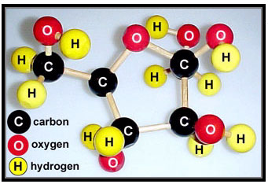
What Graphs are good for?
Most of existing data mining algorithms are based on transaction representation, i.e., sets of items.
Datasets with structures, layers, hierarchy and/or geometry often do not fit well in this transaction setting. For e.g.
  Numerical simulations
  3D protein structures
  Chemical Compounds
  Generic XML files.

Slide 8
Graph Based Data Mining
Graph Mining is the problem of discovering repetitive subgraphs occurring in the input graphs.
Motivation:
  finding subgraphs capable of compressing the data by abstracting instances of the substructures.
  identifying conceptually interesting patterns

Slide 9
Why Graph Mining?
Graphs are everywhere
  Chemical compounds (Cheminformatics)
  Protein structures, biological pathways/networks (Bioinformactics)
  Program control flow, traffic flow, and workflow analysis
  XML databases, Web, and social network analysis
Graph is a general model
  Trees, lattices, sequences, and items are degenerated graphs
Diversity of graphs
  Directed vs. undirected, labeled vs. unlabeled (edges & vertices), weighted, with angles & geometry (topological vs. 2-D/3-D)
Complexity of algorithms: many problems are of high complexity (NP complete or even P-SPACE !)

Slide 10
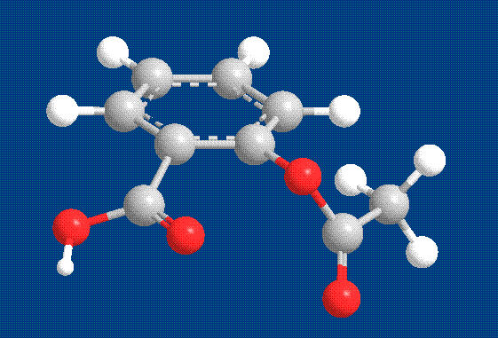
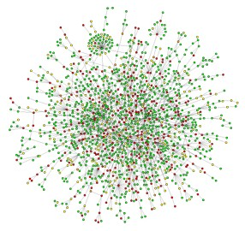
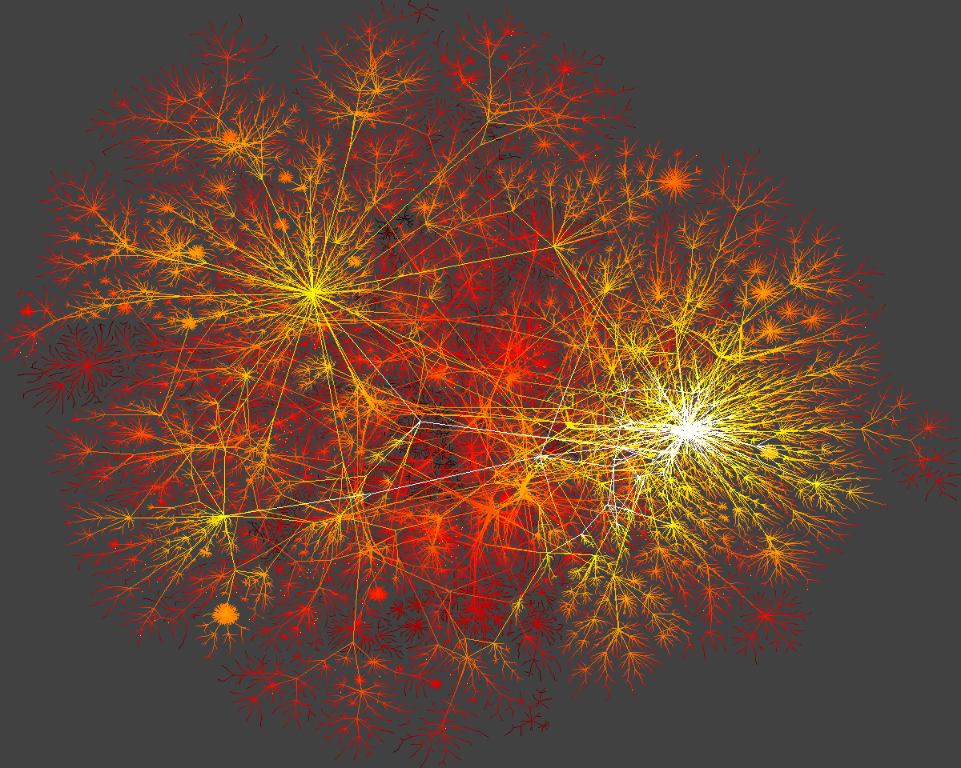
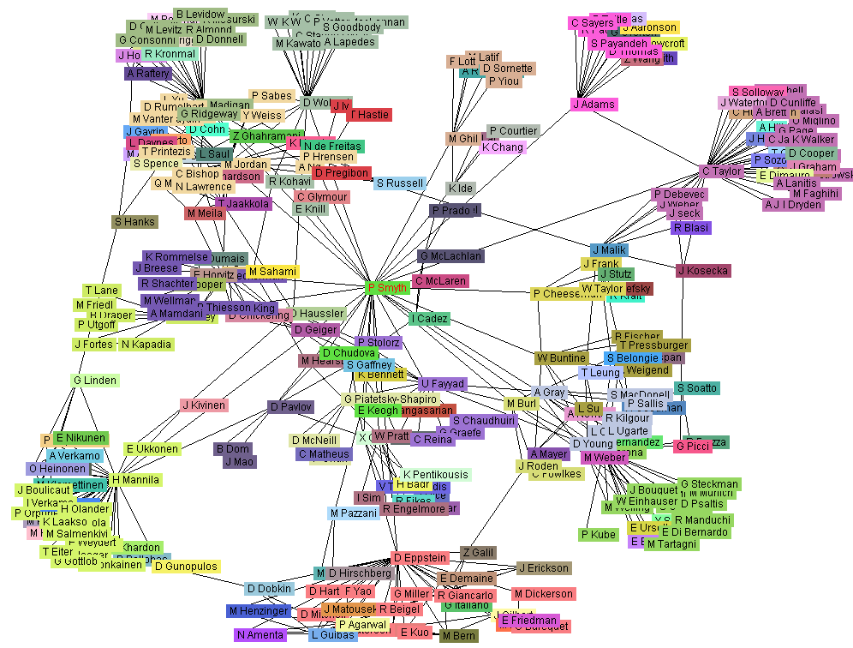
Graphs, Graphs, Everywhere
from H. Jeong et al Nature 411, 41 (2001)
Aspirin
Yeast protein interaction network
Internet
Co-author network

Slide 11
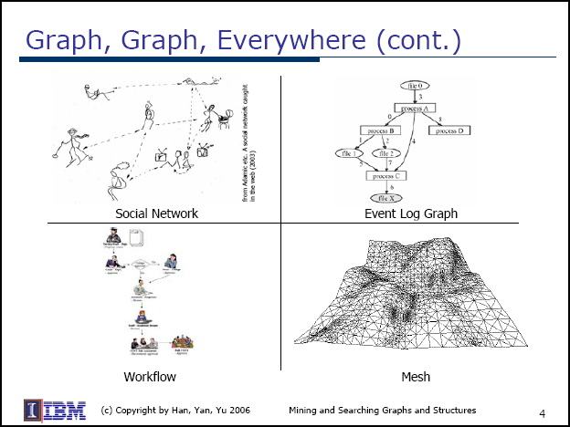

Slide 12
Modeling Data With Graphs…
Going Beyond Transactions
Data Instance
Graph Instance
Graphs are suitable for capturing arbitrary relations between the various elements.
Element
Vertex
Element’s Attributes
Vertex Label
Relation Between
Two Elements
Edge
Type Of Relation
Edge Label
Relation between a Set of Elements
Hyper Edge
Provide enormous flexibility for modeling the underlying data as they allow the modeler to decide on what the elements should be and the type of relations to be modeled

Slide 13
Graph Pattern Mining
Frequent subgraphs
  A (sub)graph is frequent if its support (occurrence frequency) in a given dataset is no less than a minimum support threshold
Applications of graph pattern mining:
  Mining biochemical structures
  Program control flow analysis
  Mining XML structures or Web communities
  Building blocks for graph classification, clustering, compression, comparison, and correlation analysis

Slide 14
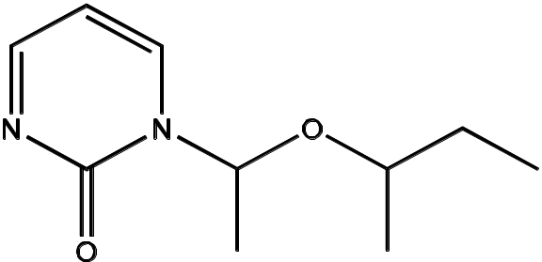
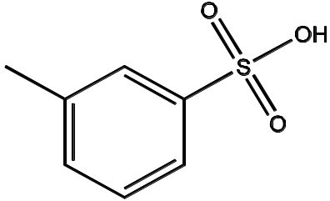
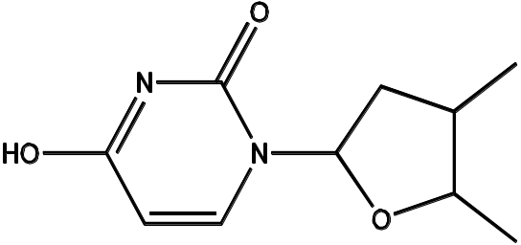
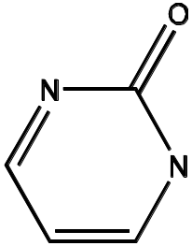
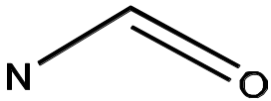
Example 1
GRAPH DATASET
(T1)
(T2)
(T3)
FREQUENT PATTERNS
(MIN SUPPORT IS 2)
(1)
(2)

Slide 15
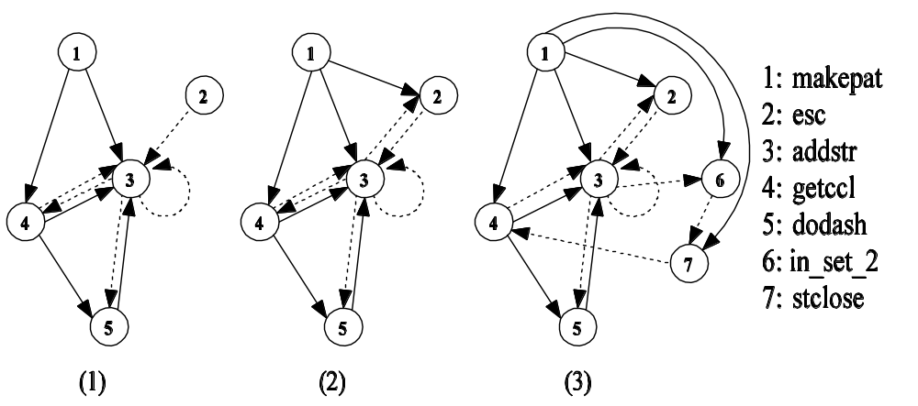
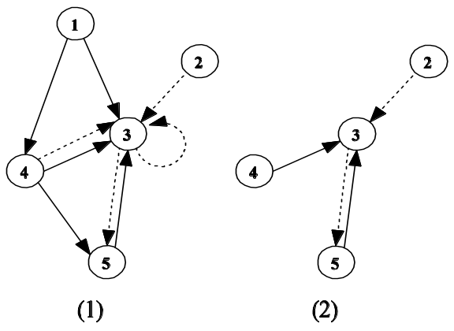
Example 2
GRAPH DATASET
FREQUENT PATTERNS
(MIN SUPPORT IS 2)

Slide 16
Graph Mining Algorithms
Simple path patterns (Chen,Park,Yu 98)
Generalized path patterns (Nanopoulos,Manolopoulos 01)
Simple tree patterns (Lin,Liu,Zhang, Zhou 98)
Tree-like patterns (Wang,Huiqing,Liu 98)
General graph patterns (Kuramochi,Karypis 01, Han 02 etc.)

Slide 17
Graph mining methods
Apriori-based approach
Pattern-growth approach

Slide 18
Apriori-Based Approach
(k+1)-graph
k-graph
G₁
G
G₂
G’
…
G’’
G_{n}
join

Slide 19
Pattern Growth Method
(k+2)-graph
(k+1)-graph
G₁
…
k-graph
G₂
duplicate
graphs
G
…
G_{n}
…
Notes:
Apriori:
Step1: Join two k-1 edge graphs (these two graphs share a same k-2 edge subgraph) to generate a k-edge graph
Step2: Join the tid-list of these two k-1 edge graphs, then see whether its count is larger than the minimum support
Step3: Check all k-1 subgraph of this k-edge graph to see whether all of them are frequent
Step4: After G successfully pass Step1-3, do support computation of G in the graph dataset, See whether it is really frequent.
gSpan:
Step1: Right-most extend a k-1 edge graph to several k edge graphs.
Step2: Enumerate the occurrence of this k-1 edge graph in the graph dataset, meanwhile, counting these k edge graphs.
Step3: Output those k edge graphs whose support is larger than the minimum support.
Pros:
1: gSpan avoid the costly candidate generation and testing some infrequent subgraphs.
2: No complicated graph operations, like joining two graphs and calculating its k-1 subgraphs.
3. gSpan is very simple
The key is how to do right most extension efficiently in graph. We invented DFS code for graph.

Slide 20
Outline
Introduction
Motivation and applications of Graph Mining
Mining Frequent Subgraphs – Transaction setting
  BFS/Apriori Approach (FSG and others)
  DFS Approach (gSpan and others)
  Greedy Approach
Mining Frequent Subgraphs – Single graph setting
  The support issue
  Path mining algorithm
  Constraint-based mining

Slide 21
Transaction Setting
Input: (D, minSup)
  Set of labeled-graphs transactions D={T₁, T₂, …, T_{N}}
  Minimum support minSup
Output: (All frequent subgraphs).
  A subgraph is frequent if it is a subgraph of at least minSup⋅|D| (or #minSup) different transactions in D.
  Each subgraph is connected.

Slide 22
Single graph setting
Input: (D, minSup)
  A single graph D (e.g. the Web or DBLP or an XML file)
  Minimum support minSup
Output: (All frequent subgraphs).
  A subgraph is frequent if the number of its occurrences in D is above an admissible support measure (measure that satisfies the downward closure property).

Slide 23
Graph Mining: Transaction Setting

Slide 24
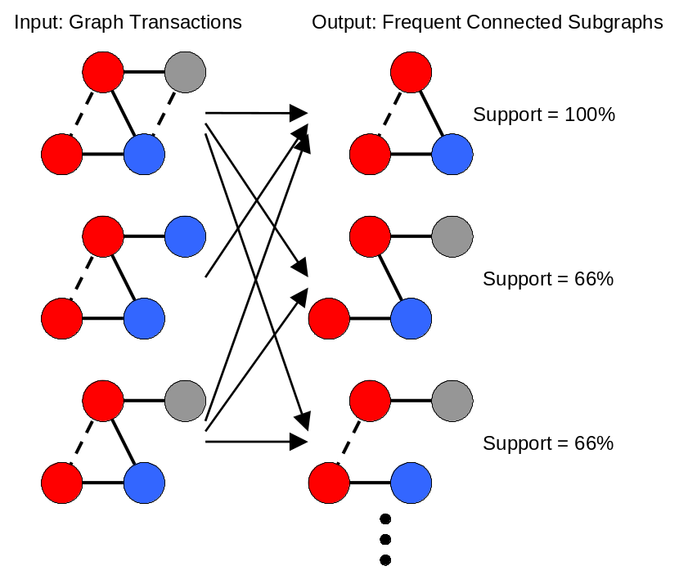
Finding Frequent Subgraphs:
Input and Output
Input
  Database of graph transactions.
  Undirected simple graph
  (no loops, no multiples edges).
  Each graph transaction has labels associated with its vertices and edges.
  Transactions may not be connected.
  Minimum support threshold σ.
Output
  Frequent subgraphs that satisfy the minimum support constraint.
  Each frequent subgraph is connected.

Slide 25

Different Approaches for GM
Apriori Approach
  FSG
  Path Based
DFS Approach
  gSpan
Greedy Approach
  Subdue

Slide 26
FSG Algorithm
[M. Kuramochi and G. Karypis. Frequent subgraph discovery. ICDM 2001]
Notation: k-subgraph is a subgraph with k edges.
Init: Scan the transactions to find F₁, the set of all frequent
1-subgraphs and 2-subgraphs, together with their counts;
For (k=3; F_{k-1} ≠ ∅ ; k++)
  Candidate Generation - C_{k}, the set of candidate k-subgraphs, from F_{k-1}, the set of frequent (k-1)-subgraphs;
  Candidates pruning - a necessary condition of candidate to be frequent is that each of its (k-1)-subgraphs is frequent.
  Frequency counting - Scan the transactions to count the occurrences of subgraphs in C_{k};
  F_{k} = { c ∈C_{K} | c has counts no less than #minSup }
  Return F₁ ∪ F₂ ∪ ……∪ F_{k} (= F )

Slide 27
Trivial operations are complicated with graphs
Candidate generation
  To determine two candidates for joining, we need to check for graph isomorphism.
Candidate pruning
  To check downward closure property, we need graph isomorphism.
Frequency counting
  Subgraph isomorphism for checking containment of a frequent subgraph.

Slide 28
Candidates generation (join) based on core detection
+
+
+

Slide 29
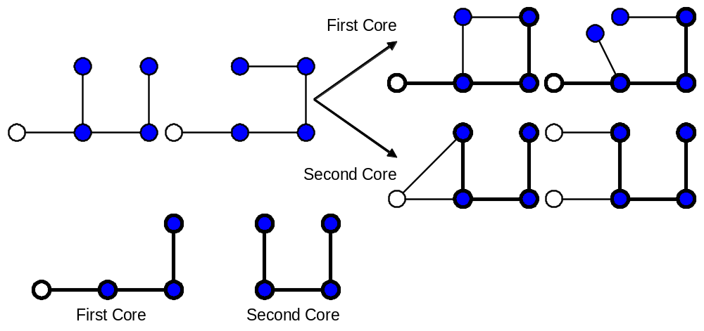
Candidate Generation Based On Core Detection (cont. )
Multiple cores between two
(k-1)-subgraphs

Slide 30
Candidate pruning:downward closure property
Every (k-1)-subgraph must be frequent.
For all the (k-1)-subgraphs of a given k-candidate, check if downward closure property holds
3-candidates:
4-candidates:

Slide 31
frequent
1-subgraphs
frequent
2-subgraphs
3-candidates
frequent
3-subgraphs
4-candidates
. . .
. . .
frequent
4-subgraphs

Slide 32
Computational Challenges
Simple operations become complicated & expensive when dealing with graphs…
Candidate generation
  To determine if we can join two candidates, we need to perform subgraph isomorphism to determine if they have a common subgraph.
  There is no obvious way to reduce the number of times that we generate the same subgraph.
  Need to perform graph isomorphism for redundancy checks.
  The joining of two frequent subgraphs can lead to multiple candidate subgraphs.
Candidate pruning
  To check downward closure property, we need subgraph isomorphism.
Frequency counting
  Subgraph isomorphism for checking containment of a frequent subgraph

Slide 33
Computational Challenges
Key to FSG’s computational efficiency:
  Uses an efficient algorithm to determine a canonical labeling of a graph and use these “strings” to perform identity checks (simple comparison of strings!).
  Uses a sophisticated candidate generation algorithm that reduces the number of times each candidate is generated.
  Uses an augmented TID-list based approach to speedup frequency counting.

Slide 34
FSG: Canonical representation for graphs (based on adjacency matrix)
a a b
Code(M₁) = “abyzx”
Code(M₂) = “abaxyz”
M₁ :
a
 | y | z
y |  | x
z | x
a
a
Graph G:
b
y
z
a b a
M₂ :
a
 | x | y
x |  | z
y | z
a
x
b
b
Code(G) = min{ code(M) | M is adj. Matrix}
a

Slide 35
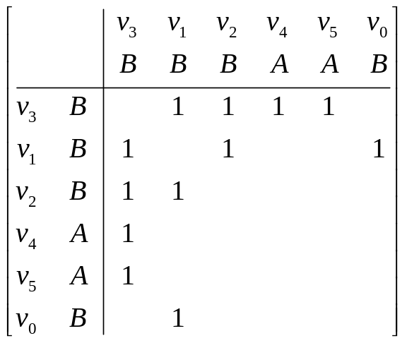
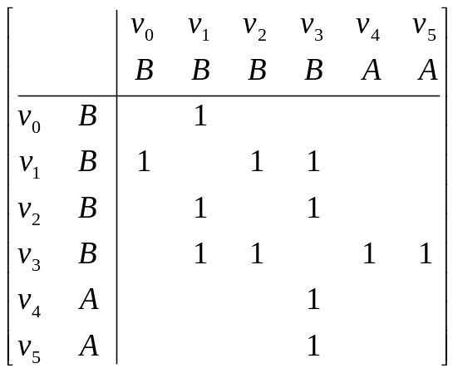
Canonical labeling
v₁
v₄
B
A
B
B
v₃
v₀
v₂
v₅
B
A
Label = “1 11 100 1000 01000”
Label = “1 01 011 0001 00010”

Slide 36
FSG: Finding the canonical labeling
  The problem is as complex as graph isomorphism, but FSG suggests some heuristics to speed it up such as:
    Vertex Invariants (e.g. degree)
    Neighbor lists
    Iterative partitioning

Slide 37
Another FSG Heuristic: frequency counting
Transactions
g^{k-1}₁ , g^{k-1}₂ ⊂ T1
g^{k-1}₁ ⊂ T2
g^{k-1}₁ , g^{k-1}₂ ⊂ T3
g^{k-1}₂ ⊂ T6
g^{k-1}₁ ⊂ T8
g^{k-1}₁ , g^{k-1}₂ ⊂ T9
Frequent subgraphs
TID(g^{k-1}₁) = { 1, 2, 3, 8, 9 }
TID(g^{k-1}₂) = { 1, 3, 6, 9 }
Candidate
c^{k} = join(g^{k-1}₁, g^{k-1}₂)
TID(c^{k}) ⊂ TID(g^{k-1}₁) ∩ TID(g^{k-1}₂)
⇓
TID(c^{k} ) ⊂ { 1, 3, 9}
Perform subgraph-iso to T1, T3 and T9 with c^{k} and determine TID(c^{k})
Note, TID lists require a lot of memory.

Slide 38
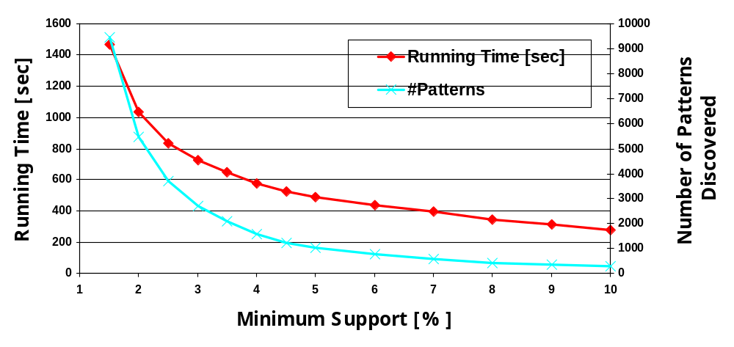
FSG performance on DTP Dataset (chemical compounds)

Slide 39
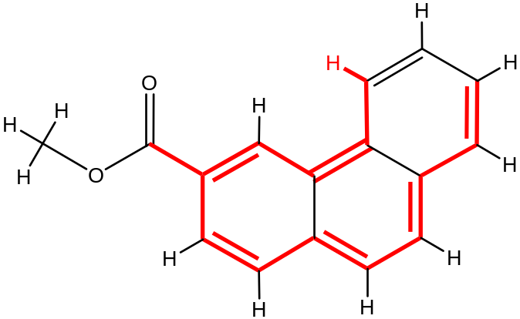
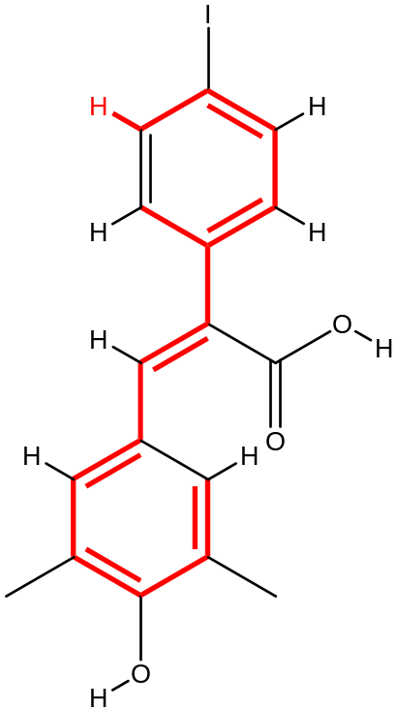
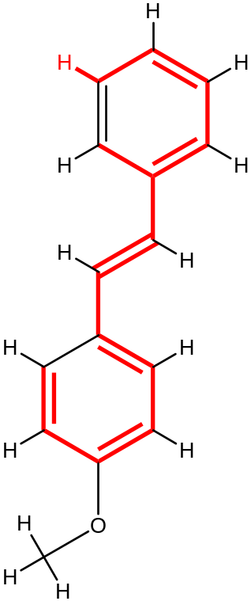
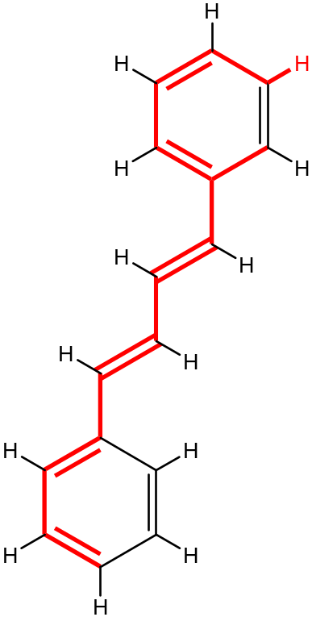
Topology Is Not Enough (Sometimes)
Graphs arising from physical domains have a strong geometric nature.
  This geometry must be taken into account by the data-mining algorithms.
Geometric graphs.
  Vertices have physical 2D and 3D coordinates associated with them.

Slide 40
gFSG—Geometric Extension Of FSG (Kuramochi & Karypis ICDM 2002)
C
Same input and same output as FSG
  Finds frequent geometric connected subgraphs
Geometric version of (sub)graph isomorphism
  The mapping of vertices can be translation, rotation, and/or scaling invariant.
  The matching of coordinates can be inexact as long as they are within a tolerance radius of r.
    R-tolerant geometric isomorphism.
B
A

Slide 41
Different Approaches for GM
Apriori Approach
  FSG
  Path Based
DFS Approach
  gSpan
Greedy Approach
  Subdue
Y. Xifeng and H. Jiawei
gSpan: Graph-Based Substructure Pattern Mining
ICDM, 2002.

Slide 42
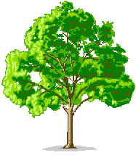
gSpan outline
part1:
Define the Tree Search Space (TSS)
Part2:
Find all frequent graphs
by exploring TSS

Slide 43
Motivation: DFS exploration wrt. itemsets.
Itemset search space – prefix based
abcde
abcd
abce
abde
acde
bcde
abc
abd
abe
acd
ace
ade
bcd
bce
bde
cde
ab
ac
ad
ae
bc
bd
be
cd
ce
de
a
b
c
d
e

Slide 44
Motivation for TSS
Canonical representation of itemset is obtained by a complete order over the items.
Each possible itemset appear in TSS exactly once - no duplications or omissions.
Properties of Tree search space
  for each k-label, its parent is the k-1 prefix of the given k-label
  The relation among siblings is in ascending lexicographic order.

Slide 45
DFS Code representation
Map each graph (2-Dim) to a sequential DFS Code (1-Dim).
Lexicographically order the codes.
Construct TSS based on the lexicographic order.

Slide 46
DFS Code construction
Given a graph G. for each Depth First Search over graph G, construct the corresponding DFS-Code.
(a)
(b)
(c)
(d)
(e)
(f)
(g)
v₀
X
v₀
X
v₀
X
v₀
X
v₀
X
v₀
X
v₀
X
a
a
a
a
a
a
a
a
v₁
a
v₁
a
v₁
a
v₁
a
v₁
a
v₁
a
Y
Y
Y
Y
Y
Y
Y
b
d
b
d
b
d
b
d
b
d
b
d
b
b
X
X
b
X
b
X
b
X
b
X
b
d
b
v₂
v₂
v₂
v₂
X
c
Z
c
Z
c
Z
c
Z
c
Z
c
Z
c
v₂
Z
Z
Z
Z
Z
Z
v₃
Z
v₃
Z
v₃
v₄
(0,1,X,a,Y)
(1,2,Y,b,X)
(2,0,X,a,X)
(2,3,X,c,Z)
(3,1,Z,b,Y)
(1,4,Y,d,Z)

Slide 47
Single graph, several DFS-Codes
G
v₀
X
X
a
a
a
v₁
a
 | (a) | (b) | (c)
1 | (0, 1, X, a, Y) | (0, 1, Y, a, X) | (0, 1, X, a, X)
2 | (1, 2, Y, b, X) | (1, 2, X, a, X) | (1, 2, X, a, Y)
3 | (2, 0, X, a, X) | (2, 0, X, b, Y) | (2, 0, Y, b, X)
4 | (2, 3, X, c, Z) | (2, 3, X, c, Z) | (2, 3, Y, b, Z)
5 | (3, 1, Z, b, Y) | (3, 0, Z, b, Y) | (3, 0, Z, c, X)
6 | (1, 4, Y, d, Z) | (0, 4, Y, d, Z) | (2, 4, Y, d, Z)
Y
Y
b
d
b
d
b
X
b
X
v₄
c
c
v₂
Z
Z
Z
Z
v₃
(a)
v₀
v₀
Y
d
v₄
X
a
Z
a
v₁
X
b
v₁
X
b
b
a
c
a
v₂
X
v₂
Y
d
c
b
v₄
v₃
v₃
Z
Z
Z
(b)
(c)

Slide 48
Single graph - single Min DFS-code!
Min
DFS-Code
G
v₀
X
X
a
a
 | (a) | (b) | (c)
1 | (0, 1, X, a, Y) | (0, 1, Y, a, X) | (0, 1, X, a, X)
2 | (1, 2, Y, b, X) | (1, 2, X, a, X) | (1, 2, X, a, Y)
3 | (2, 0, X, a, X) | (2, 0, X, b, Y) | (2, 0, Y, b, X)
4 | (2, 3, X, c, Z) | (2, 3, X, c, Z) | (2, 3, Y, b, Z)
5 | (3, 1, Z, b, Y) | (3, 0, Z, b, Y) | (3, 0, Z, c, X)
6 | (1, 4, Y, d, Z) | (0, 4, Y, d, Z) | (2, 4, Y, d, Z)
a
v₁
a
Y
Y
b
d
b
d
b
X
b
X
v₄
c
c
v₂
Z
Z
Z
Z
v₃
(a)
v₀
v₀
Y
d
v₄
X
a
Z
a
v₁
X
b
v₁
X
b
b
a
c
a
v₂
X
v₂
Y
d
c
b
v₄
v₃
v₃
Z
Z
Z
(b)
(c)

Slide 49
Minimum DFS-Code
The minimum DFS code min(G), in DFS lexicographic order, is a canonical representation of graph G.
Graphs A and B are isomorphic if and only if:
min(A) = min(B)

Slide 50
DFS-Code Tree: parent-child relation
If min(G₁) = { a₀, a₁, ….., a_{n}}
and min(G₂) = { a₀, a₁, ….., a_{n}, b}
  G₁ is parent of G₂
  G₂ is child of G₁
A valid DFS code requires that b grows from a vertex on the rightmost path (inherited property from the DFS search).

Slide 51
v₀
Graph G₁:
X
a
a
v₁
Y
b
d
b
X
c
v₂
Z
v₄
Z
v₃
Min(g) =
(0,1,X,a,Y)
(1,2,Y,b,X)
(2,0,X,a,X)
(2,3,X,c,Z)
(3,1,Z,b,Y)
(1,4,Y,d,Z)
A child of graph G₁ must grow edge from rightmost path of G₁ (necessary condition)
Graph G₂:
v₀
v₅
v₀
X
?
X
?
a
?
a
wrong
a
v₁
a
v₁
?
Y
?
v₅
Y
b
?
b
d
b
d
b
X
?
v₅
X
c
v₂
c
v₂
Z
Z
?
v₄
v₄
Z
Z
v₃
v₅
?
v₃
?
Forward EDGE
Backward EDGE

Slide 52
Search space: DFS code Tree
Organize DFS Code nodes as parent-child.
Sibling nodes organized in ascending DFS lexicographic order.
InOrder traversal follows DFS lexicographic order!

Slide 53
0
A
A
1
C
…
2
C
3
Min
DFS-Code
Not Min DFS-Code
0
0
0
0
A
A
A
C
0
0
0
0
A
C
1
B
1
C
1
C
B
B
1
C
P R U N E D
A
A
1
1
1
C
1
C
C
B
2
C
2
B
2
C
B
2
A
3
C
3
2
2
3
3
S
3
2
2
S’
3
0
0
0
0
0
A
A
B
B
C
0
A
1
1
1
1
1
C
A
B
C
B
C
1
2
2
2
2
2
0
0
0
A
B
C
1
1
1

Slide 54
Tree pruning
All of the descendants of infrequent node are infrequent also.
All of the descendants of a not minimal DFS code are also not minimal DFS codes.

Slide 55
part1:
defining the Tree Search Space (TSS)
Part2:
gSpan Finds all frequent graphs
by Exploring TSS

Slide 56
gSpan Algorithm
gSpan(D, F, g)
1: if g ≠ min(g)
return;
2: F ← F ∪ { g }
3: children(g) ← [generate all g’ potential children with one edge growth]*
4: Enumerate(D, g, children(g))
5: for each c ∈ children(g)
if support(c) ≥ #minSup
SubgraphMining (D, F, c)
___________________________
* gSpan improve this line

Slide 57
Example
Given: database D
T1
T2
c
T3
a
b
a
a
b
b
a
a
c
c
a
b
c
b
a
c
c
c
a
c
b
Task: Mine all frequent subgraphs with support ≥ 2 (#minSup)

Slide 58
T1
T2
c
T3
a
b
a
a
b
b
a
a
c
c
a
b
c
b
a
c
c
c
a
c
b
0
A
TID={1,3}
A
1
C
2
C
3
TID={1,3}
0
A
A
1
C
2
TID={1,3}
TID={1,2,3}
TID={1,2,3}
0
0
0
A
A
A
1
1
A
B
C
1
2
2
TID={1,2,3}
0
0
0
A
B
C
1
1
1

Slide 59
T1
T2
c
T3
a
b
a
a
b
b
a
a
c
c
a
b
c
b
a
c
c
c
a
c
b
0
A
A
1
C
2
C
3
TID={1,2}
0
0
A
A
A
C
1
C
1
B
2
2
TID={1,2,3}
TID={1,2,3}
0
0
0
A
A
A
1
1
A
B
C
1
2
2
0
0
0
A
B
C
1
1
1

Slide 60
T1
T2
c
T3
a
b
a
a
b
b
a
a
c
c
a
b
c
b
a
c
c
c
a
c
b
0
A
A
1
C
2
C
3
0
0
0
0
0
A
A
A
0
1
1
1
B
0
A
A
A
C
B
C
C
B
1
1
2
2
2
1
C
1
C
C
B
C
B
C
B
3
C
3
2
2
3
3
3
2
2
0
0
0
0
0
0
A
A
B
B
C
A
1
1
1
1
1
A
B
C
B
C
C
1
2
2
2
2
2
0
0
0
A
B
C
1
1
1

Slide 61
gSpan Performance
On synthetic datasets it was 6-10 times faster than FSG.
On Chemical compounds datasets it was 15-100 times faster!
But this was comparing to OLD versions of FSG!

Slide 62
Different Approaches for GM
Apriori Approach
  FSG
  Path Based
DFS Approach
  gSpan
Greedy Approach
  Subdue
D. J. Cook and L. B. Holder
Graph-Based Data Mining
Tech. report, Department of CS Engineering, 1998

Slide 63
Graph Pattern Explosion Problem
If a graph is frequent, all of its subgraphs are frequent ─ the Apriori property
An n-edge frequent graph may have 2^{n} subgraphs.
Among 422 chemical compounds which are confirmed to be active in an AIDS antiviral screen dataset, there are 1,000,000 frequent graph patterns if the minimum support is 5%.

Slide 64
Subdue algorithm
A greedy algorithm for finding some of the most prevalent subgraphs.
This method is not complete, i.e. it may not obtain all frequent subgraphs, although it pays in fast execution.

Slide 65
Subdue algorithm (Cont.)
It discovers substructures that compress the original
data and represent structural concepts in the data.
Based on Beam Search - like BFS it progresses level by
level. Unlike BFS, however, beam search moves
downward only through the best W nodes at each
level. The other nodes are ignored.

Slide 66
Subdue algorithm: step 1
Step 1: Create substructure for each unique vertex label
DB:
Substructures:
triangle
on
triangle (4)
square (4)
circle (1)
rectangle (1)
square
left
circle
on
rectangle
on
left
on
left
on
triangle
triangle
triangle
on
on
on
left
left
square
square
square

Slide 67
Subdue Algorithm: step 2
Step 2: Expand best substructure by an edge or edge and neighboring vertex
DB:
Substructures:
triangle
on
left
circle
square
circle
on
square
left
circle
rectangle
on
left
on
left
on
triangle
triangle
triangle
square
rectangle
triangle
triangle
on
on
on
on
on
on
left
left
square
triangle
square
square
square
rectangle
square

Slide 68
Subdue Algorithm: steps 3-5
Step 3: Keep only best substructures on queue (specified by beam width).
Step 4: Terminate when queue is empty or when the number of discovered substructures is greater than or equal to the limit specified.
Step 5: Compress graph and repeat to generate hierarchical description.

Slide 69
Outline
Introduction
Motivation and applications for Graph mining
Mining Frequent Subgraphs – Transaction setting
  BFS/Apriori Approach (FSG and others)
  DFS Approach (gSpan and others)
  Greedy Approach
Mining Frequent Subgraphs – Single graph setting
  The support issue
  Path mining algorithm
  Constraint-based mining

Slide 70
Single Graph Setting
Most existing algorithms use a transaction setting approach.
That is, if a pattern appears in a transaction even multiple times it is counted as 1 (FSG, gSPAN ).
What if the entire database is a single graph?
This is called single graph setting.
We need a different support definition!

Slide 71
Single graph setting - Motivation
Often the input is a single large graph.
Examples:
  The web or portions of it.
  A social network (e.g. a network of users communicating by email at BGU).
  A large XML database such as DBLP or Movies database.
Mining large graph databases is very useful.

Slide 72
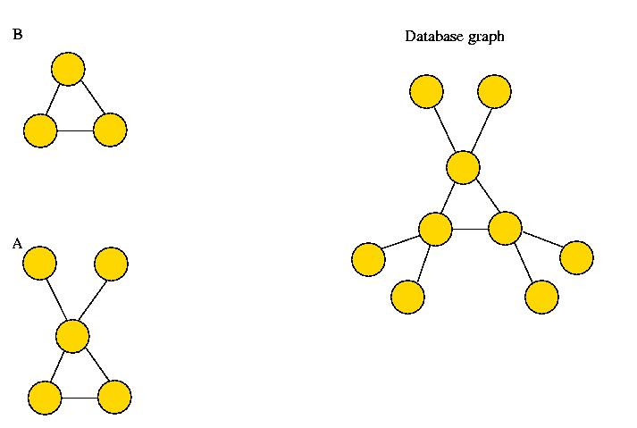
Support issue
Support measure is admissible if for any pattern P and any sub-pattern Q ⊂ P support of P is not larger than support of Q.
Problem: the number of pattern appearances is not good!

Slide 73
Support issue
An instance graph of pattern P in database graph D is a graph whose nodes are pattern instances in D and they are connected by an edge when corresponding instances share an edge.

Slide 74
Support issue
Operations on instance graph:
clique contraction: replace clique C by a single node c. Only the nodes adjacent to each node of C may be adjacent to c.
node expansion: replace node v by a new subgraph whose nodes may or may not be adjacent to the nodes adjacent to v.
node addition: add a new node to the graph and arbitrary edges between the new node and the old ones.
edge removal : remove an edge.

Slide 75
The main result
Theorem. A support measure S is an admissible support measure if and only if it is non-decreasing on instance graph of every pattern P under clique contraction, node expansion, node addition and edge removal.

Slide 76
Example of support measure - MIS
Maximum independent set size of instance graph
MIS = _____________________________________
Number of edges in the database graph

Slide 77
Path mining algorithm (Vanetik, Gudes, Shimony)
Goal: find all frequent connected subgraphs
of a database graph.
Basic approach: Apriori or BFS.
  The basic building block is a path not an edge.
  This works since any graph can be decomposed into
  edge-disjoint paths.
Result: faster convergence of the algorithm.

Slide 78
Path-based mining algorithm
The algorithm uses paths as basic building blocks for pattern construction.
It starts with one-path graphs and combines them into 2-, 3- etc. path graphs.
The combination technique does not use graph operations and is easy to implement.
Path number of a graph is computed in linear time: it is the number of odd-degree vertices divided by two.
Given minimal path cover P, removal of one path creates a graph with minimal path cover size |P|-1.
There exist at least two paths in P whose removal leaves the graph connected.

Slide 79
More than one path cover for graph
Define a descriptor of each path based on node labels and node degrees.
Use lexicographical order among descriptors to compare between paths.
One graph can have several minimal path covers.
We only use path covers that are minimal w.r.t. lexicographical order.
Removal of path from a lexicographically minimal path cover leaves the cover lexicographically minimal.

Slide 80
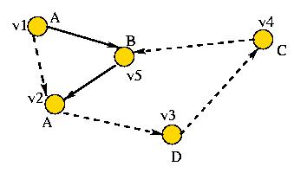
Example: path descriptors
P₁ = v1,v2,v3,v4,v5 P₂ = v1,v5,v2
Desc (P₁) = <A,0,1>,<A,1,1>,<B,1,0>,<C,1,1>,<D,1,1>
Desc (P₂) = <A,0,1>,<A,1,0>,<B,1,1>

Slide 81
Path mining algorithm
Phase 1: find all frequent 1-path graphs.
Phase 2: find all frequent 2-path graphs by
“joining” frequent 1-path graphs.
Phase 3: find all frequent k-path graphs, k≥3,
by “joining” pairs of frequent (k-1)-path graphs.
Main challenge: “join” must ensure soundness
and completeness of the algorithm.

Slide 82
Graph as collection of paths: table representation
Node | P₁ | P₂ | P₃
v1 | a1 | ⊥ | ⊥
v2 | a2 | b2 | ⊥
v3 | a3 | ⊥ | ⊥
v4 | ⊥ | b1 | ⊥
v5 | ⊥ | b3 | c3
v6 | ⊥ | ⊥ | c1
v7 | ⊥ | ⊥ | c2
Graph composed
from 3 paths:

Slide 83
Removing path from table
Node | P₁ | P₂ | P₃
v1 | a1 | ⊥ | ⊥
v2 | a2 | b2 | ⊥
v3 | a3 | ⊥ | ⊥
v4 | ⊥ | b1 | ⊥
v5 | ⊥ | b3 | c3
v6 | ⊥ | ⊥ | c1
v7 | ⊥ | ⊥ | c2
Node | P₁ | P₂
v1 | a1 | ⊥
v2 | a2 | b2
v3 | a3 | ⊥
v4 | ⊥ | b1
v5 | ⊥ | b3
delete P₃

Slide 84
Join graphs with common paths: the sum operation
C3
 | P₁ | P₂ | P₃ | P₄
v1 | a1
v2 | a2 | b2
v3 | a3
v4 |  | b1 |  | d1
v4 |  | b3 | c3
v6 |  |  | c1
v7 |  |  | c2
v8 |  |  |  | d2
v9 |  |  |  | d3
C₁
 | P₁ | P₂ | P₃
v1 | a1
v2 | a2 | b2
v3 | a3
v4 |  | b1
v5 |  | b3 | c3
v6 |  |  | c1
v7 |  |  | c2
C₂
 | P₁ | P₂ | P₄
v1 | a1
v2 | a2 | b2
v3 | a3
v4 |  | b1 | d1
v5 |  | b3
v6 |  |  | d2
v7 |  |  | d3
Join on P₁,P₂
+

Slide 85
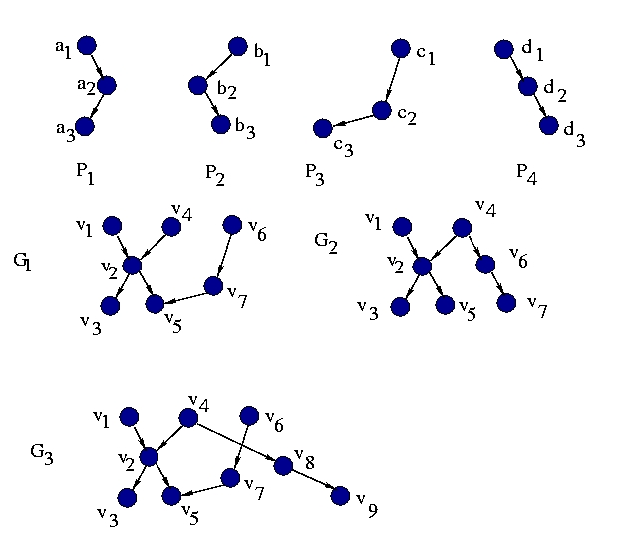
The sum operation: how it looks on graphs

Slide 86
The sum is not enough: the splice operation
We need to construct a frequent n-path graph G on paths P1,…,Pn.
We have two frequent (n-1)-path graphs, G1 on paths P1,…,Pn-1 and G2 on paths P2,…,Pn.
The sum of G1 and G2 will give us n-path graph G’ on paths P1,…,Pn.
G’=G if P1 and Pn have no common node that belongs solely to them.
A frequent 2-path graph H containing P1 and Pn exactly as they appear in G exists if G is frequent.
Let us join the nodes of P1 and Pn in G’ according to H.
This is the splice operation!

Slide 87
The splice operation: an example
G₁
 |  | P₂ | P₃
v1 | v1
v2 | v2 | b2
v3 | v3
v4 | v4 | b1
v5 | v5 | b3 | c3
v6 | v6 |  | c1
v7 | v7 |  | c2
G₃
 | P₁ | P₂ | P₃
v1 | a1
v2 | a2 | b2
v3 | a3
v4 |  | b1 | c1
v5 |  | b3 | c3
v6 |  |  | c2
G₂
 | P₂ | P₃
v2 | b1 | c1
v4 | b2
v5 | b3 | c3
v7 |  | c2
Splice G₁
with G₂

Slide 88
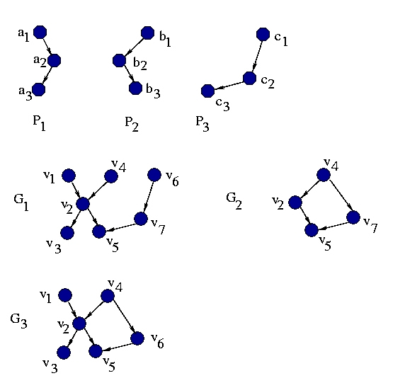
The splice operation: how it looks on graph

Slide 89
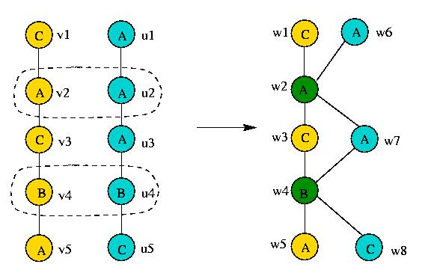
Labeled graphs: we mind the labels
We join only nodes that have the same labels!

Slide 90
Path mining algorithm
  Find all frequent edges.
  Find frequent paths by adding one edge at a time
  (not all nodes are suitable for this!)
  Find all frequent 2-path graphs by exhaustive joining.
  Set k=2.
  While frequent k-path graphs exist:
    Perform sum operation on pairs of frequent k-path graphs
    where applicable.
    Perform splice operation on generated (k+1)-path candidates
      To get additional (k+1)-path candidates.
    Compute support for (k+1)-path candidates.
    Eliminate non-frequent candidates and set k:=k+1.
    Go to 5.

Slide 91
Complexity
Exponential – as the number of frequent patterns can be exponential
on the size of the database (like any Apriori alg.)
Difficult tasks: (NP hard)
    Support computation that consists of:
      Finding all instances of a frequent pattern in
      the database. (sub-graph isomorphism)
      Computing MIS (maximum independent set size)
      of an instance graph.
Relatively easy tasks:
    Candidate set generation:
    polynomial on the size of frequent set from
    previous iteration,
    Elimination of isomorphic candidate patterns:
    graph isomorphism computation is at worst
    exponential on the size of a pattern, not the database.

Slide 92
Additional Approaches for Single Graph Setting
BFS Approach
  hSiGram
DFS Approach
  vSiGram
Both use approximations of the MIS measure
M. Kuramochi and G. Karypis
Finding Frequent Patterns in a Large Sparse Graph
In Proc. Of SIAM 2004.

Slide 93
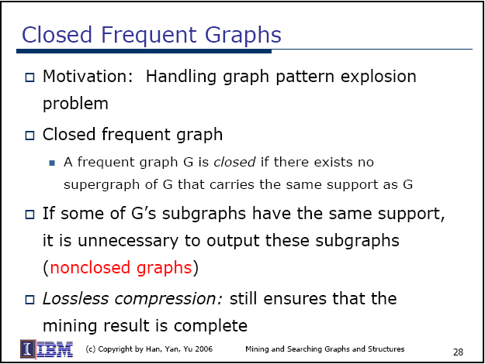

Slide 94
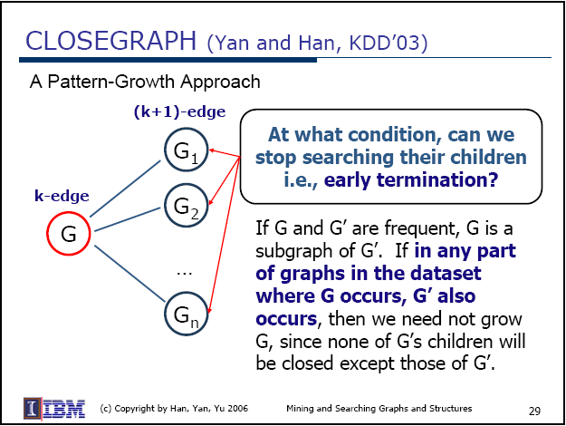

Slide 95
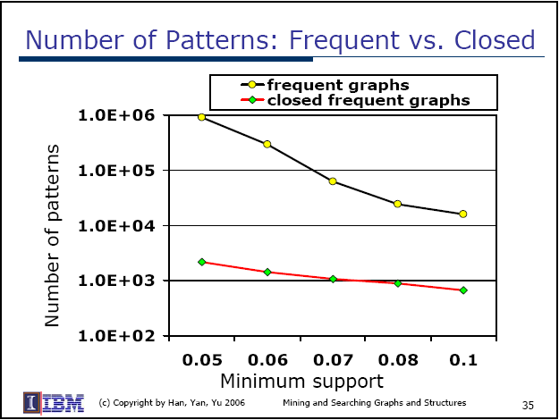

Slide 96
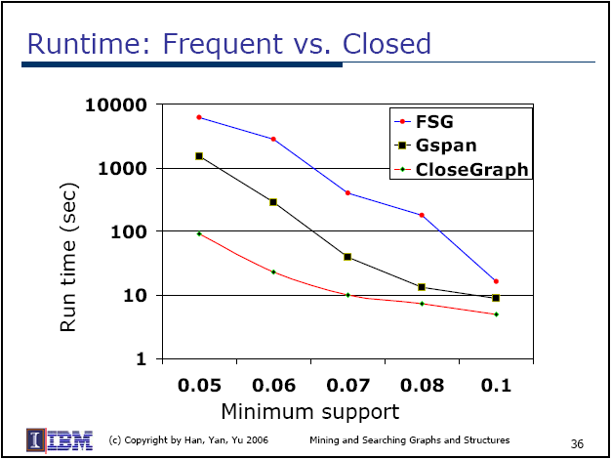

Slide 97
Conclusions
Data Mining field proved its practicality during its short lifetime with effective DM algorithms.
Many applications in Databases, Chemistry&Biology, Networks, etc.
Both Transaction and Single graph settings are important
Graph Mining is:
  Dealing with designing effective algorithms for mining graph datasets.
  Facing many hardness problems on the way.
  Fast growing field with many possibilities of evolving unseen before.
As more and more information is stored in complicated structures, we need to develop new set of algorithms for Graph Data Mining.

Slide 98
Some References
[1] T. Washio A. Inokuchi and H.~Motoda, An Apriori-Based Algorithm for Mining Frequent Substructures from Graph Data, Proceedings of the 4th PKDD'00, 2000, pages 13-23.
[2] M. Kuramochi and G. Karypis, An Efficient Algorithm for Discovering Frequent Subgraphs, Tech. report, Department of Computer Science/Army HPC Research Center, 2002.
[3] N. Vanetik, E.Gudes, and S. E. Shimony, Computing Frequent Graph Patterns from Semistructured Data, Proceedings of the 2002 IEEE ICDM'02
[4] Y. Xifeng and H. Jiawei, gspan: Graph-Based Substructure Pattern Mining, Tech. report, University of Illinois at Urbana-Champaign, 2002.
[5] W. Wang J. Huan and J. Prins, Efficient Mining of Frequent Subgraphs in the Presence of Isomorphism, Proceedings of the 3rd IEEE ICDM'03 p.~549.
[6] Moti Cohen, Ehud Gudes, Diagonally Subgraphs Pattern Mining. DMKD 2004, pages 51-58, 2004
[7] D. J. Cook and L. B. Holder, Graph-Dased Data Mining, Tech. report, Department of CS Engineering, 1998.

Slide 99
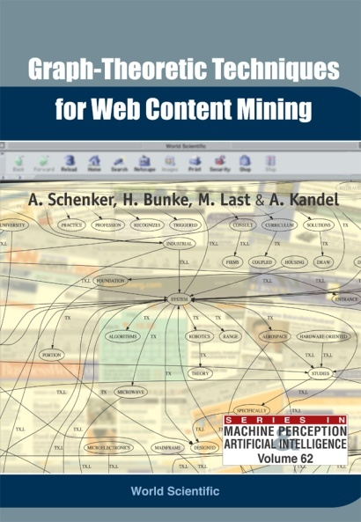
Documents Classification:
Alternative Representation of Multilingual Web Documents:The Graph-Based Model
Introduced in A. Schenker, H. Bunke, M. Last, A. Kandel, Graph-Theoretic Techniques for Web Content Mining, World Scientific, 2005

Slide 100
The Graph-Based Model of Web Documents
Basic ideas:
  One node for each unique term
  If word B follows word A, there is an edge from A to B
    In the presence of terminating punctuation marks (periods, question marks, and exclamation points) no edge is created between two words
  Graph size is limited by including only the most frequent terms
  Several variations for node and edge labeling (see the next slides)
Pre-processing steps
  Stop words are removed
  Lemmatization
    Alternate forms of the same term (singular/plural, past/present/future tense, etc.) are conflated to the most frequently occurring form
Notes:
one node for each unique term: unique labeling of nodes – no two nodes have the same label

Slide 101

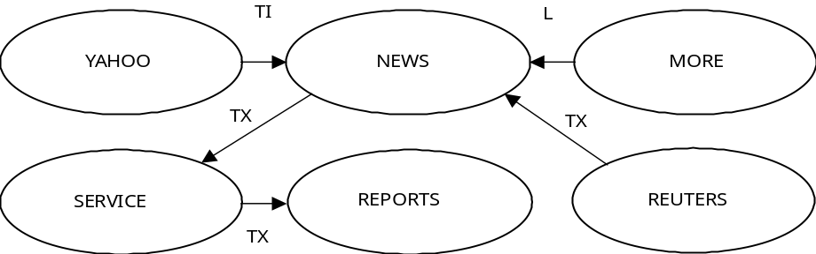
The Standard Representation
Edges are labeled according to the document section where the words are followed by each other
  Title (TI) contains the text related to the document’s title and any provided keywords (meta-data);
  Link (L) is the “anchor text” that appears in clickable hyper-links on the document;
  Text (TX) comprises any of the visible text in the document (this includes anchor text but not title and keyword text)

Slide 102
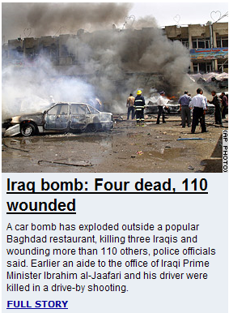
Graph Based Document Representation – Detailed Example
Source: www.cnn.com, May 24, 2005
Notes:
In next few slides we will show simple example of graph document representation process. Here we have real CNN news web page that were recently downloaded at may 24/2005. The picture is for esthetic purpose only. We still don’t use pictures and other multimedia for graph construction. Only text and some extracted HTML tags information are used.

Slide 103

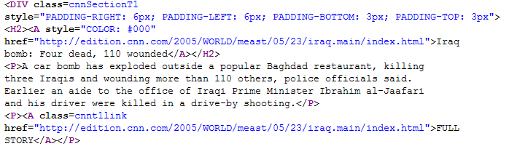
Graph Based Document Representation - Parsing
title
link
text
Notes:
During the parsing stage we recognize relevant for this particular representation sections of the document using information provided by HTML tags. We interested in text of title, links and document body that is normal, visible to user text.

Slide 104
Standard Graph Based Document Representation
TX
Ten most frequent terms are used
CAR
DRIVER
KILLING
TX
Word | Frequency
Iraqis | 3
Killing | 2
Bomb | 2
Wounding | 2
Driver | 2
Exploded | 1
Baghdad | 1
International | 1
CNN | 1
Car | 1
Text
TX
TX
IRAQIS
BOMB
L
TX
TX
Link
EXPLODED
TX
BAGHDAD
WOUNDING
Title
INTERNATIONAL
TI
CNN

Slide 105
Classification using graphs
Basic idea:
  Mine the frequent sub-graphs, call them terms
  Use TFIDF for assigning the most characteristic terms to documents
  Use Clustering and K-nearest neighbors classification
Notes:
one node for each unique term: unique labeling of nodes – no two nodes have the same label

Slide 106
Subgraph Extraction
Input
  G – training set of directed, unique nodes graphs
  CR_{min} - Minimum Classification Rate
Output
  Set of classification-relevant sub-graphs
Process:
  For each class find subgraphs CR > CR_{min}
  Combine all sub-graphs into one set
Basic Assumption
  Classification-Relevant Sub-Graphs are more frequent in a specific category than in other categories
Notes:
Second, smart method assume that relevant for classification feature is that frequent in one category and unfrequent in others. This is better assumption then we used in naïve case. We developed measure called Classification Rate that give higher weight to such subgraphs. Extraction process is pretty similar to naïve process. CR min is used as threshold.

Slide 107
Computing the Classification Rate
Subgraph Classification Rate:
SCF (g’_{k}(c_{i})) - Subgraph Class Frequency of subgraph g’_{k} in category c_{i}
ISF (g’_{k}(c_{i})) - Inverse Subgraph Frequency of subgraph g’_{k} in category c_{i}
Classification Relevant Feature is a feature that best explains a specific category, or frequent in this category more than in all others

Slide 108
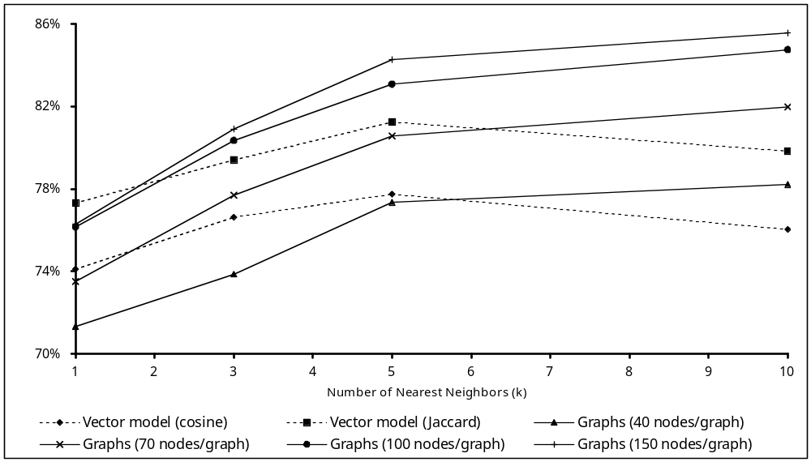
k-Nearest Neighbors with Graphs
Accuracy vs. Graph Size
Notes:
Vector models are represented by dotted lines, graph models are represented by solid lines

Slide 109
